Slide 1

CS-103 (Project)
PROJECT NAME -
“ZOMATO CLONE”
Submitted by :
Krishna Joshi (24/A04/028)

Slide 2
ZOMATO CLONE
Made by using HTML and CSS only
(A simple, modern design that resembles the aesthetic of the Zomato Website for branding consistency)

Slide 3
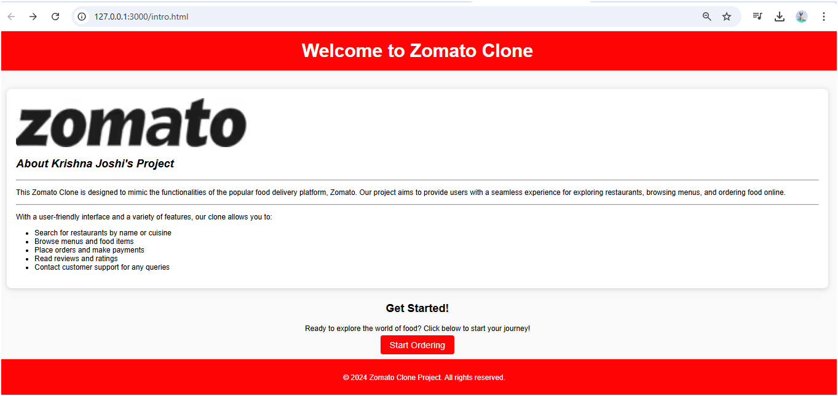

Slide 4
intro.html and intro.css
This HTML code creates an introductory webpage for a Zomato clone project. It features a header with a welcome message, followed by an introduction section displaying the project’s logo, a description, and an overview of the clone’s features. These features include searching for restaurants, browsing menus, ordering food, reading reviews, and accessing customer support. The code also includes a "Get Started" section with a button linking to the main ordering page. A footer concludes the page with copyright information. The structure is styled with an external CSS file (intro.css) for a clean, user-friendly interface.

Slide 5
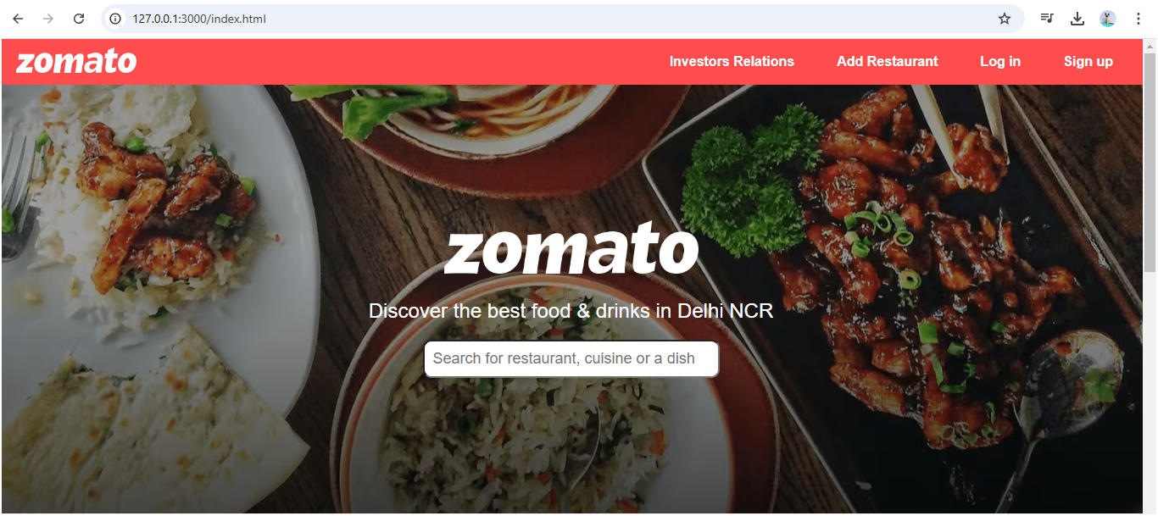
Main Page (index.html & style.css)

Slide 6
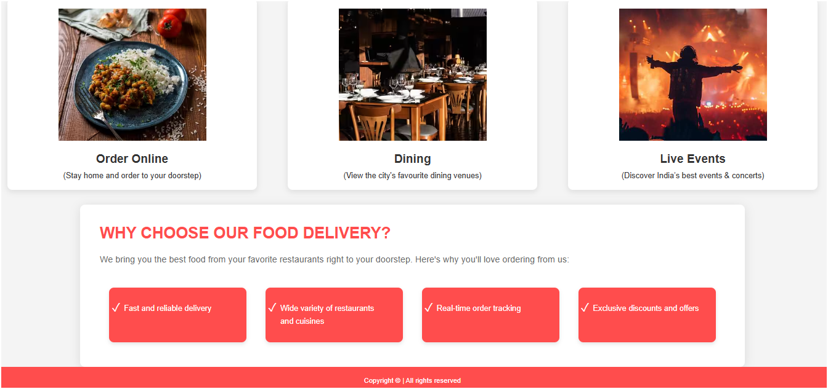

Slide 7
index.html and style.css
This HTML code builds a main landing page for a Zomato clone project, with a focus on online food ordering. The header includes navigation links for investor relations, adding a restaurant, login, and signup options. The main section features an image, a tagline targeting Delhi NCR, and a search bar for users to find restaurants or cuisines. It also highlights three primary services: ordering online, dining, and live events. Another section describes benefits of the service, such as fast delivery, a wide range of restaurants, and special discounts. A footer at the bottom provides copyright information. External styling is applied via style.css.

Slide 8
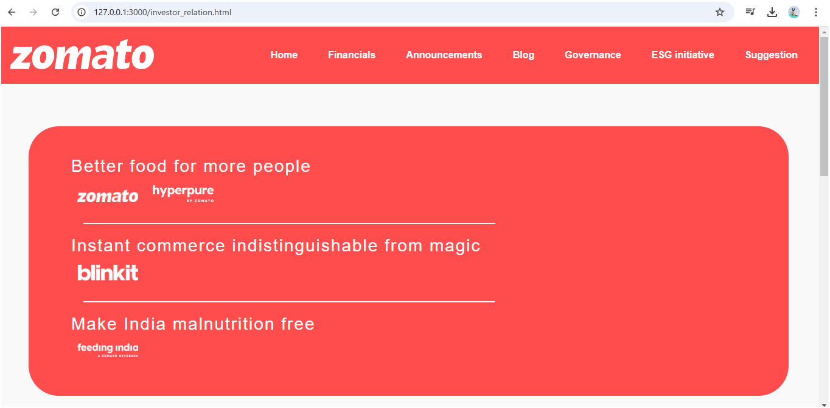
Investor Relations Page :

Slide 9
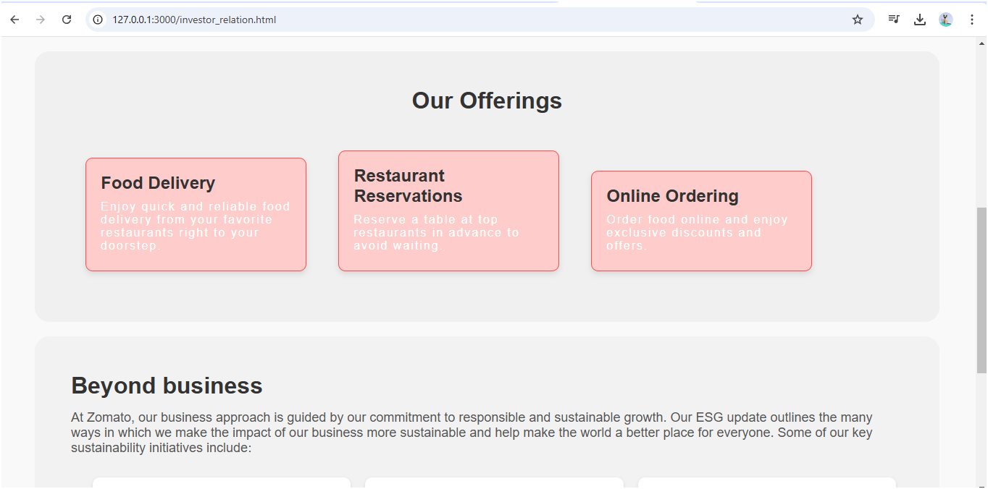

Slide 10
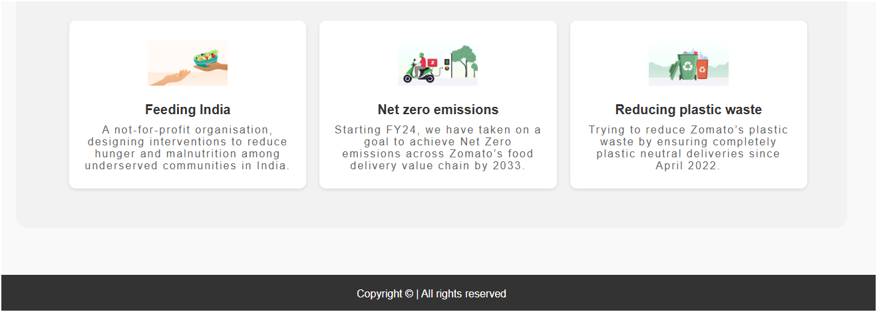

Slide 11
Investor_relations.html and investor_style.css
This HTML code creates an "Investor Relations" page for a Zomato clone project. The header includes navigation links to various sections like Financials, Announcements, Blog, Governance, ESG initiatives, and Suggestions. The main content highlights Zomato’s brand offerings, including food delivery, restaurant reservations, and online ordering. Additional sections showcase Zomato’s social and environmental initiatives, such as Feeding India (a hunger reduction program), a commitment to achieving net zero emissions by 2033, and efforts to reduce plastic waste. Each initiative is detailed with descriptions and images. The page is styled externally with investor_style.css, and a footer provides copyright details.

Slide 12
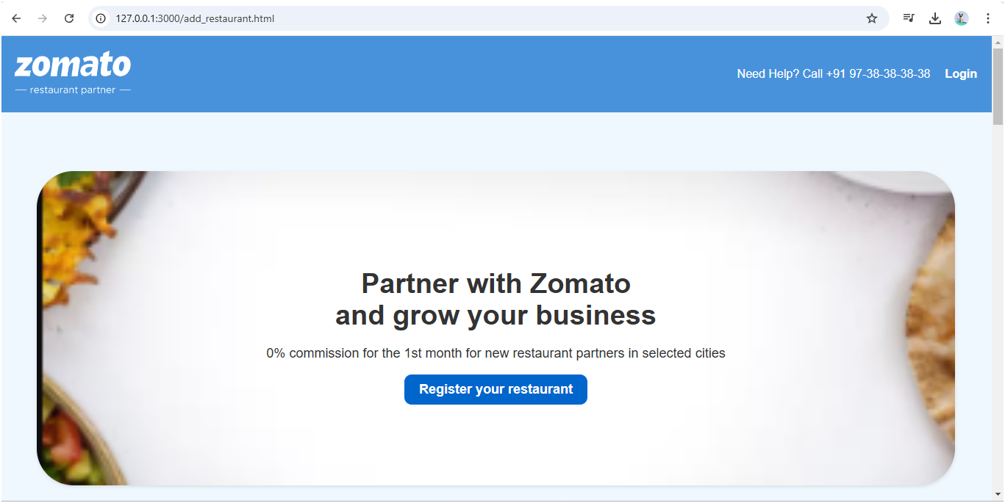
Add Restaurant Page

Slide 13
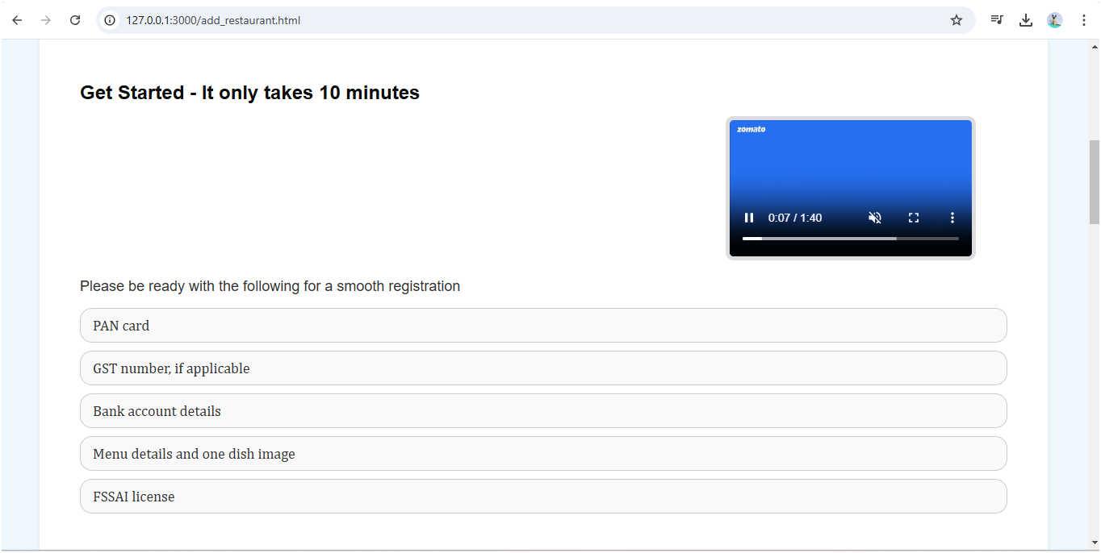

Slide 14
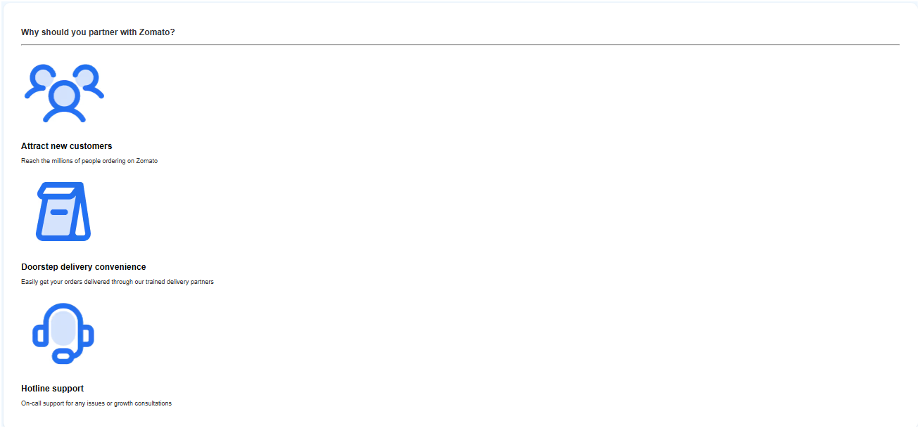

Slide 15
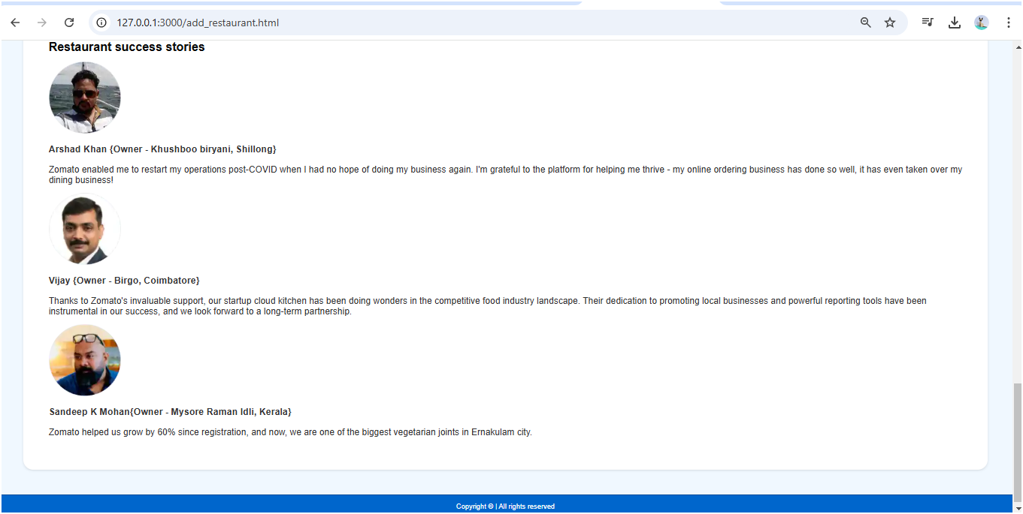

Slide 16
add_restaurant.html and add_restaurant.css
This HTML code builds a "Partner with Us" page for a Zomato clone, designed to encourage restaurant owners to join the platform. The header provides contact details and login access. The main section invites new restaurant partners with an initial zero-commission offer and a signup link. A “Get Started” section outlines required documents for registration, alongside a video explaining the process. The page highlights partnership benefits like increased customer reach, convenient delivery, and hotline support. Additionally, it features success stories from various restaurant owners who have grown with Zomato. The page is styled using an external CSS file, add_restaurant_style.css.

Slide 17
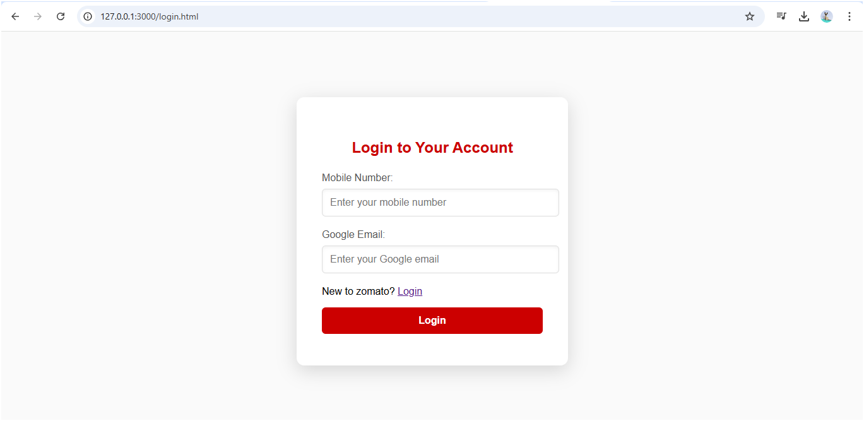
Login page

Slide 18
login.html and login_style.css
This HTML code creates a "Login" page for a Zomato clone project. The page includes a login form within a container, styled with an external CSS file login_style.css. The form features input fields for users to enter their mobile number and Google email, both marked as required. A prompt is displayed for new users, with a link that appears to lead back to the login page (likely intended for sign-up instead). The login button, designed as a link, directs users to an OTP (One-Time Password) verification page for further authentication. This design supports a simple login flow using mobile and email verification.

Slide 19
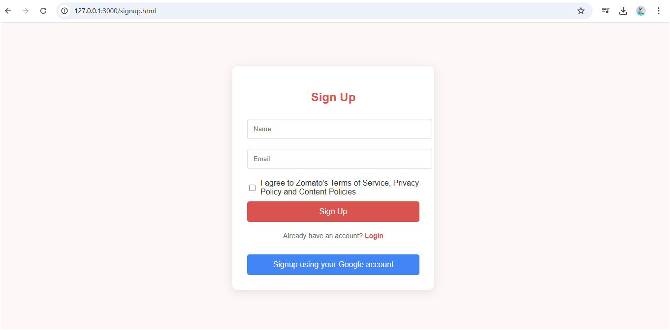
Sign up page

Slide 20
signup.html and signup_style.css
This HTML code represents a "Sign Up" page for a Zomato clone project, using an external stylesheet signup_style.css for styling. The form includes input fields for the user’s name and email, both marked as required, and a checkbox to agree to Zomato's terms and policies. A submit button, styled as a link, directs users to an OTP page (otp.html) for verification after signup. Additional options include a prompt for existing users to log in and a button to sign up using a Google account. The page structure and design provide a streamlined, user-friendly registration experience.

Slide 21
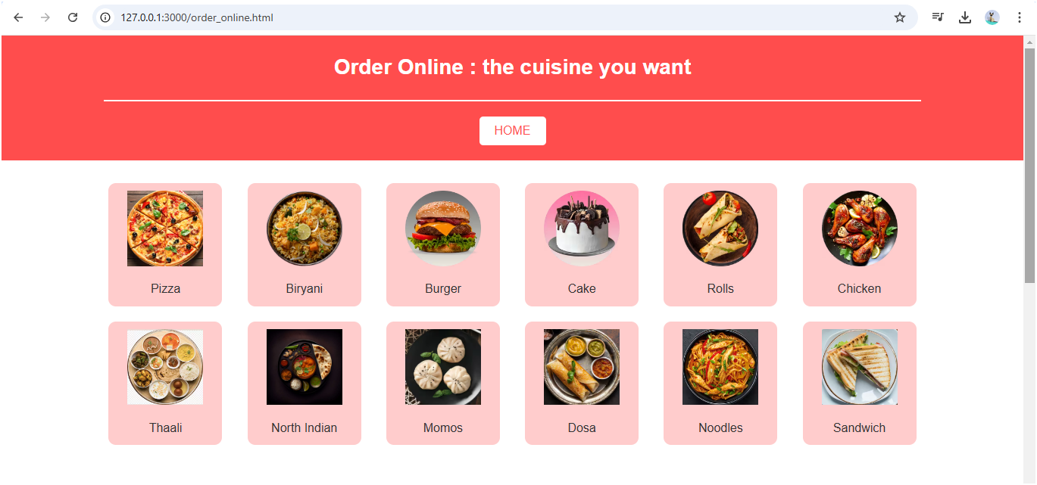
Order Online Page

Slide 22
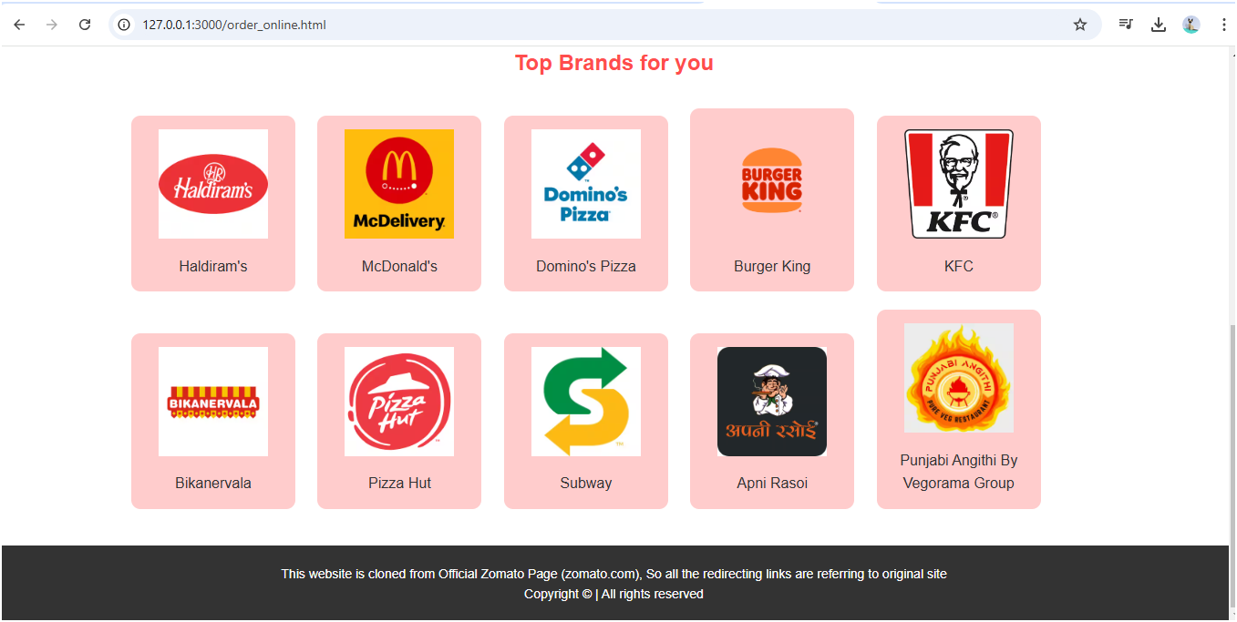

Slide 23
order_online.html and order_online.css
This HTML code is for an "Order Online" page in a Zomato clone. It includes a header with a navigation link back to the home page and displays a selection of popular cuisines as clickable items with images. Each cuisine link shows an image and name, inviting users to choose specific food options like pizza, biryani, and dosa. Below, a "Top Brands for You" section features popular restaurant brands (e.g., McDonald's, Domino's) with icons and names linked to further pages. A footer notes that links redirect to the original Zomato site, with a copyright notice at the end.

Slide 24
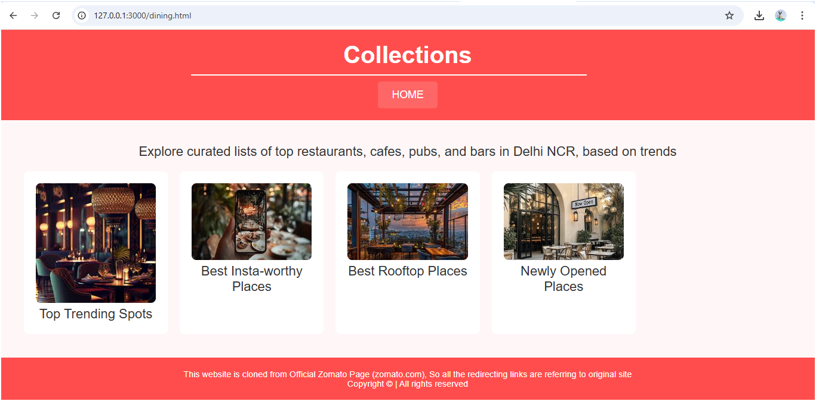
Dining Page

Slide 25
dining.html and dining.css
This HTML code creates a "Dining" page for a Zomato clone, featuring curated collections of top dining spots in Delhi NCR. The page includes a header with a title and a button to navigate to the homepage. The main section provides descriptions of different categories such as "Top Trending Spots," "Best Insta-worthy Places," "Best Rooftop Places," and "Newly Opened Places," each accompanied by an image. These categories are clickable links that likely lead to more detailed listings. The footer includes a disclaimer that the site is a clone of the official Zomato page, along with a copyright notice.

Slide 26
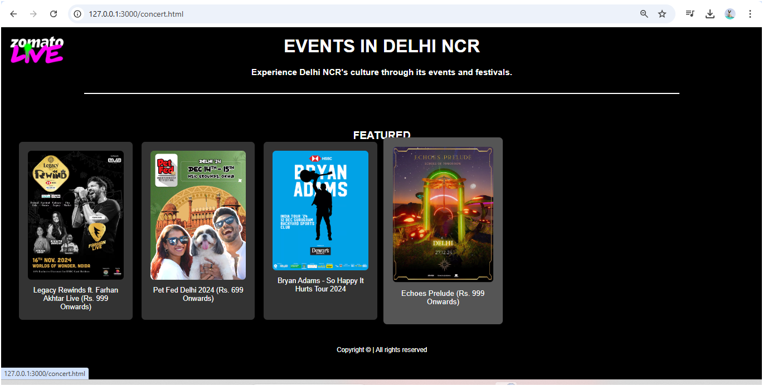
Live Events Page

Slide 27
Concert.html and concert.css
This HTML code creates a "Live Events" page for a Zomato clone, showcasing cultural events and festivals in Delhi NCR. The header includes an image and the title "EVENTS IN DELHI NCR" with a brief description. The main section highlights featured events such as "Legacy Rewinds ft. Farhan Akhtar Live," "Pet Fed Delhi 2024," "Bryan Adams - So Happy It Hurts Tour 2024," and "Echoes Prelude," each with an image and event details like pricing. The footer includes a copyright notice. The layout is simple and focused on promoting live events with engaging visuals.

Slide 28
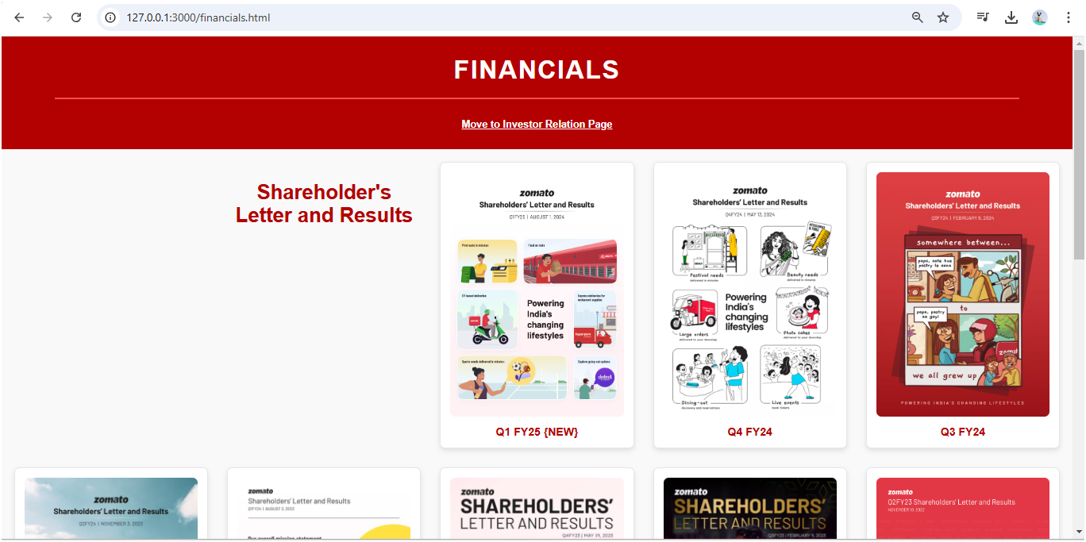
Investor Relation > Financials page

Slide 29
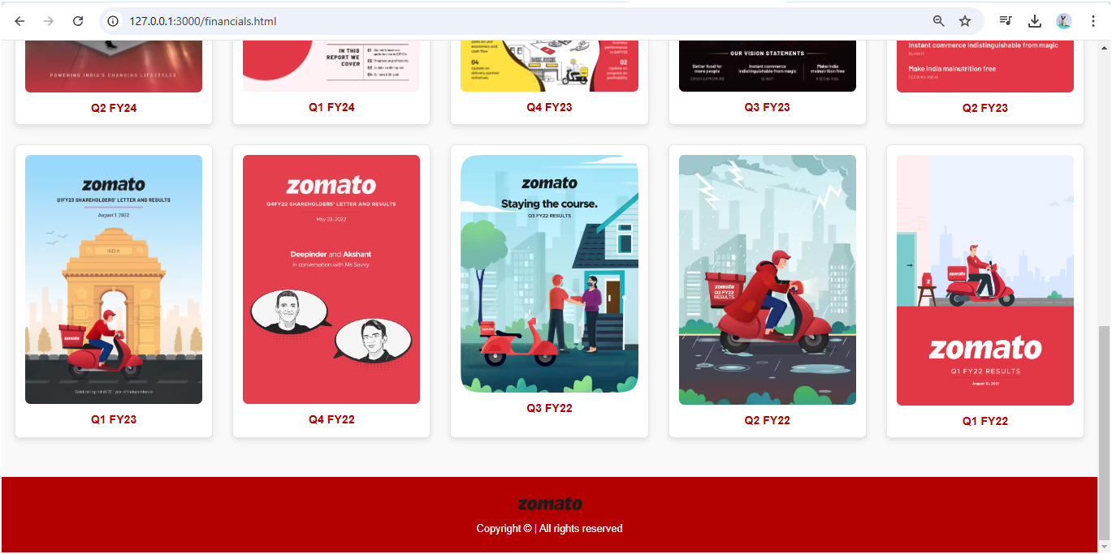

Slide 30
financials.html and financials.css
This HTML code creates a "Financials" page for an investor relations section, displaying a series of quarterly financial reports for Zomato. The header includes a title and a link to the Investor Relations page. The main section lists various financial documents for different fiscal years (Q1 to Q4 of FY22, FY23, FY24, FY25), each with a downloadable PDF link and a corresponding image. These reports are presented in a list format, with each entry linking to an external PDF. The footer includes a logo and a copyright notice. The page is styled through an external CSS file.

Slide 31
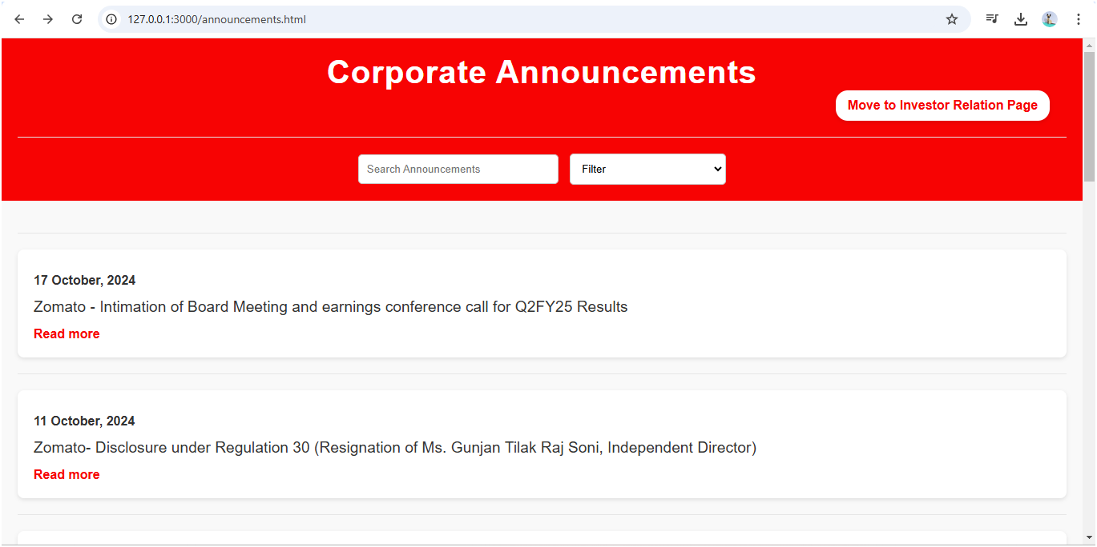
Investor Relations > Announcements page

Slide 32
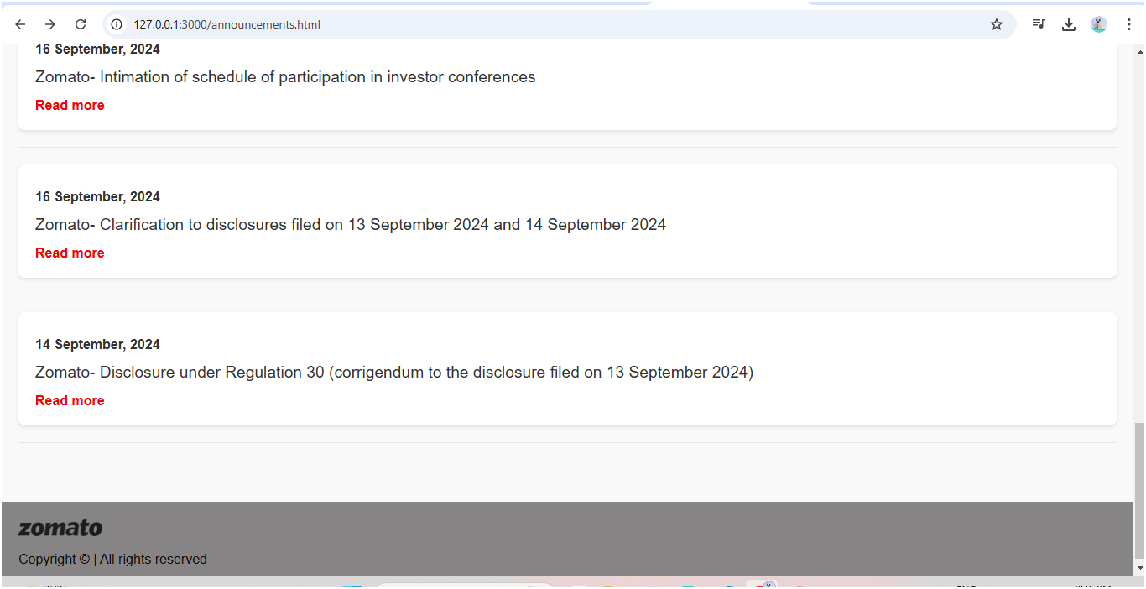

Slide 33
announcements.html and announcements.css
This HTML code creates a "Corporate Announcements" page for Zomato. The page includes a header with a title, a link to the Investor Relations page, and a search form with a filter option for sorting announcements. The main section displays a series of corporate announcements, each containing the date, a brief description, and a link to a PDF for further reading. The announcements cover various corporate matters, such as board meetings, resignations, updates, and disclosures. The footer contains a logo and copyright information. The page is styled using an external CSS file, "announcements_style.css".

Slide 34
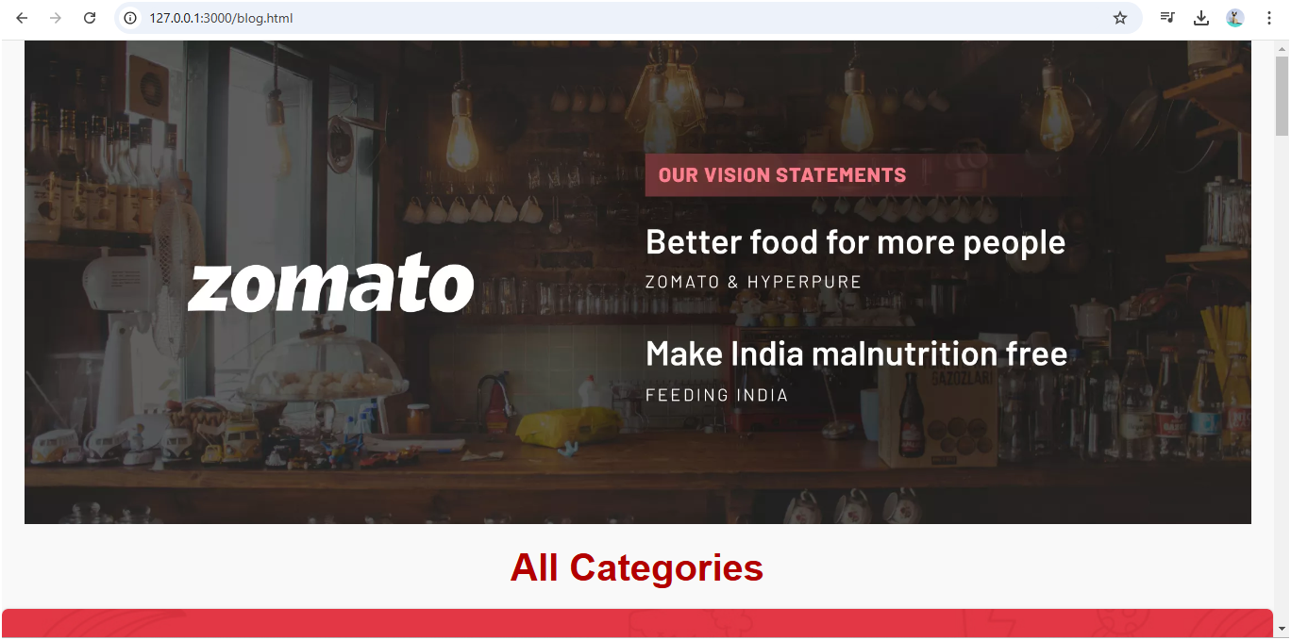
Investor Relations > Blog Page

Slide 35
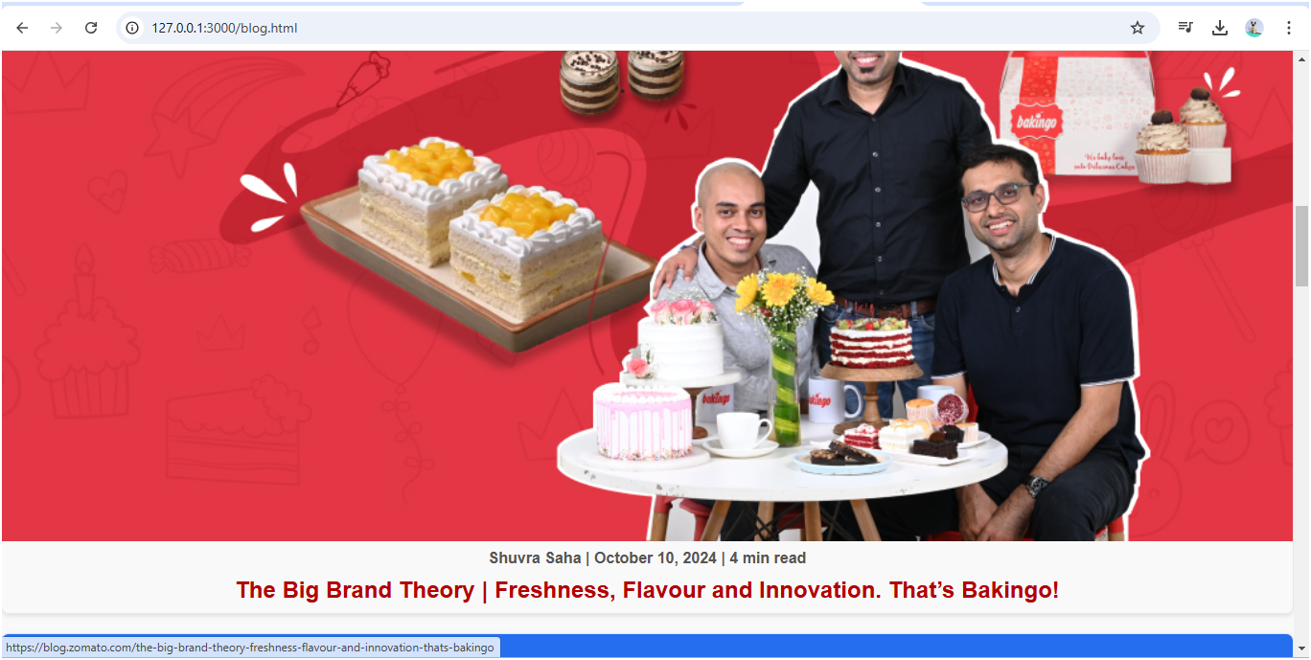

Slide 36
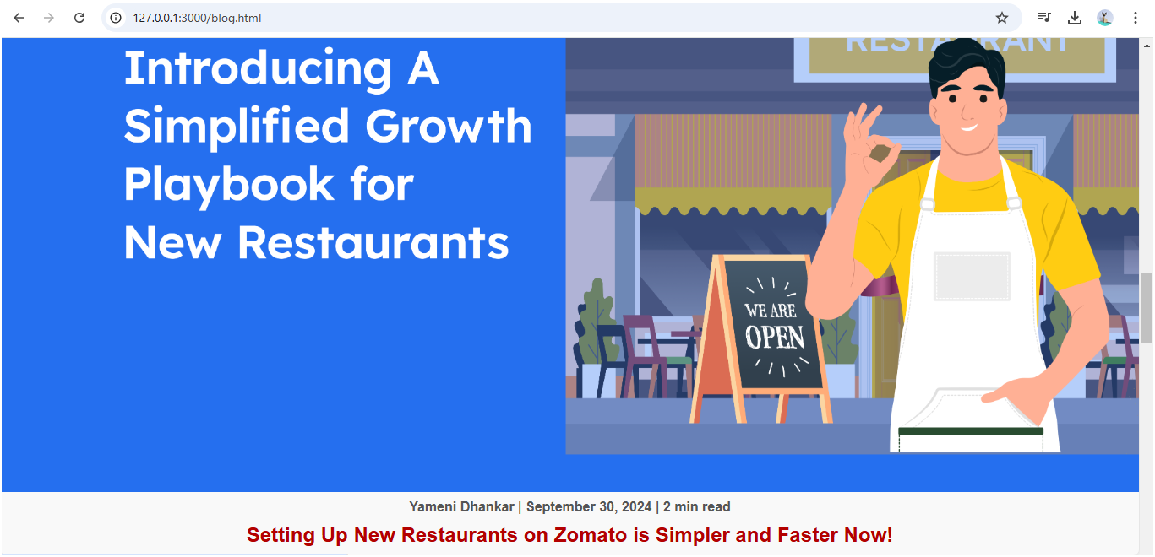

Slide 37
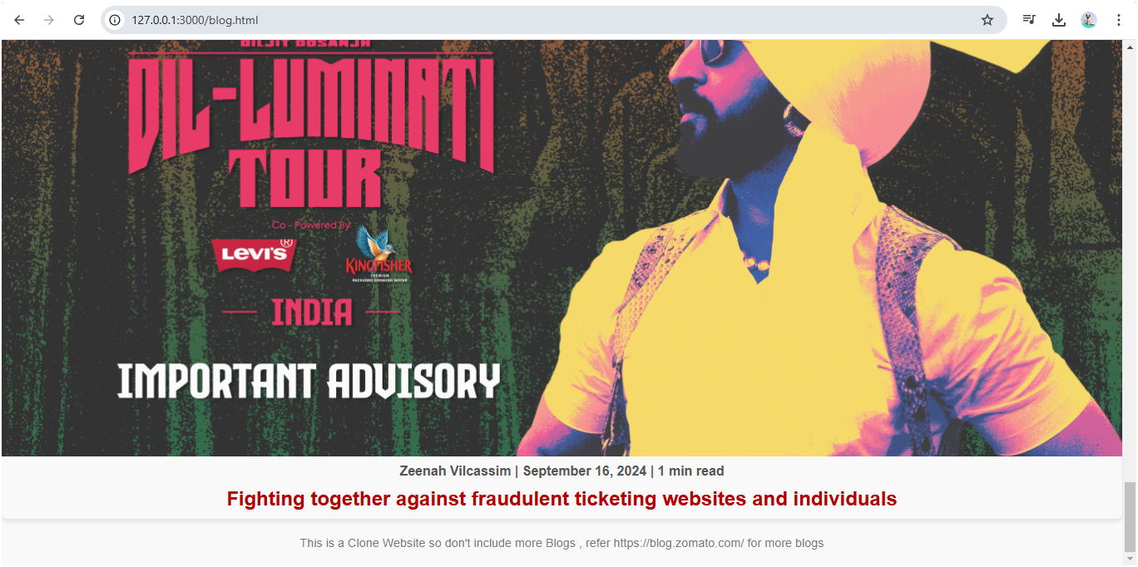

Slide 38
blog.html and blog.css
This HTML code creates a "Zomato Blog" page displaying several blog posts with featured images and brief details. The page includes a large header image and a title "All Categories." Below, there are four blog sections, each containing a clickable image that links to the full blog post. Each section includes the author's name, the publication date, and the read time. The blog posts cover various topics related to Zomato. At the bottom, there's a note indicating that this is a clone website and users can visit the original Zomato blog for more posts. The page is styled using an external CSS file.

Slide 39
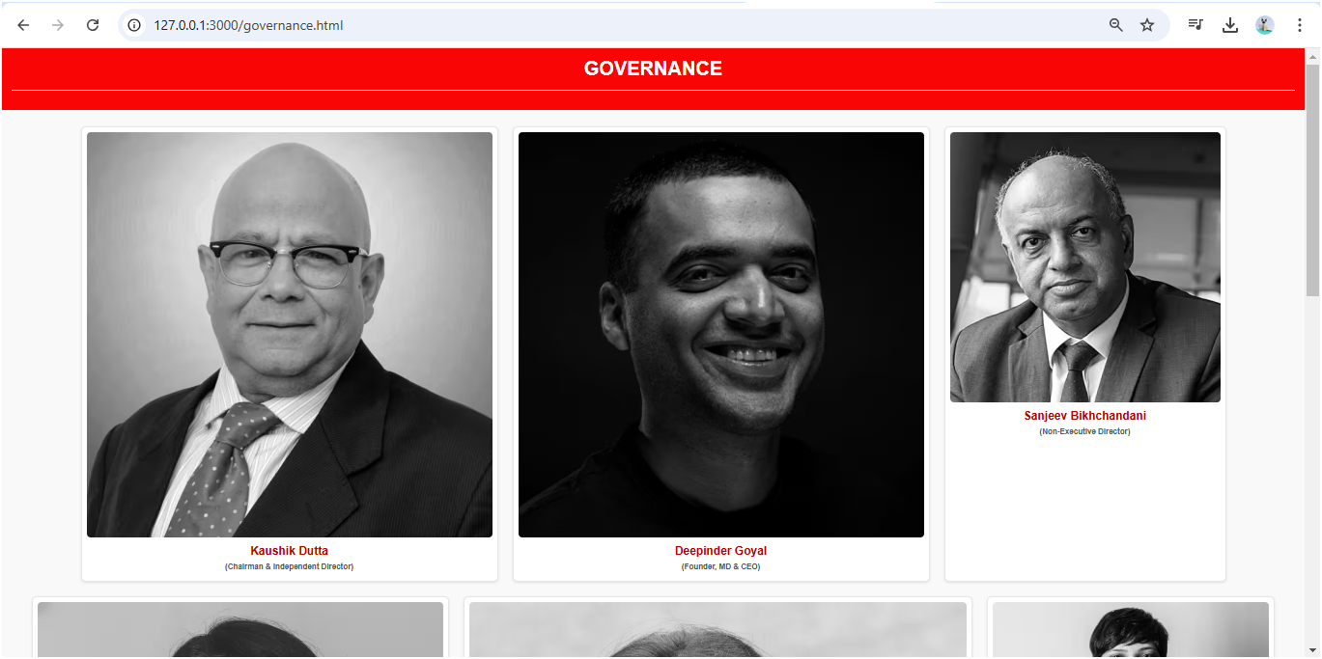
Investor Relations > Governance Page

Slide 40
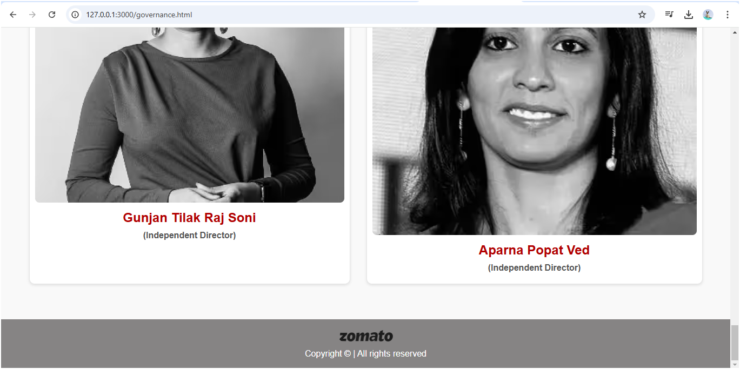

Slide 41
governance.html and governance.css
This HTML code creates a "Governance" page for a Zomato clone website, displaying a list of key individuals in the company’s leadership team. Each section shows an image, name, and position of a director or executive. The page includes members such as Kaushik Dutta (Chairman & Independent Director), Deepinder Goyal (Founder, MD & CEO), and others. The layout consists of several <div> elements, each containing an image and associated text. The page is styled using an external CSS file. A footer is included with a logo and copyright notice. The structure emphasizes clean, organized presentation of governance information

Slide 42
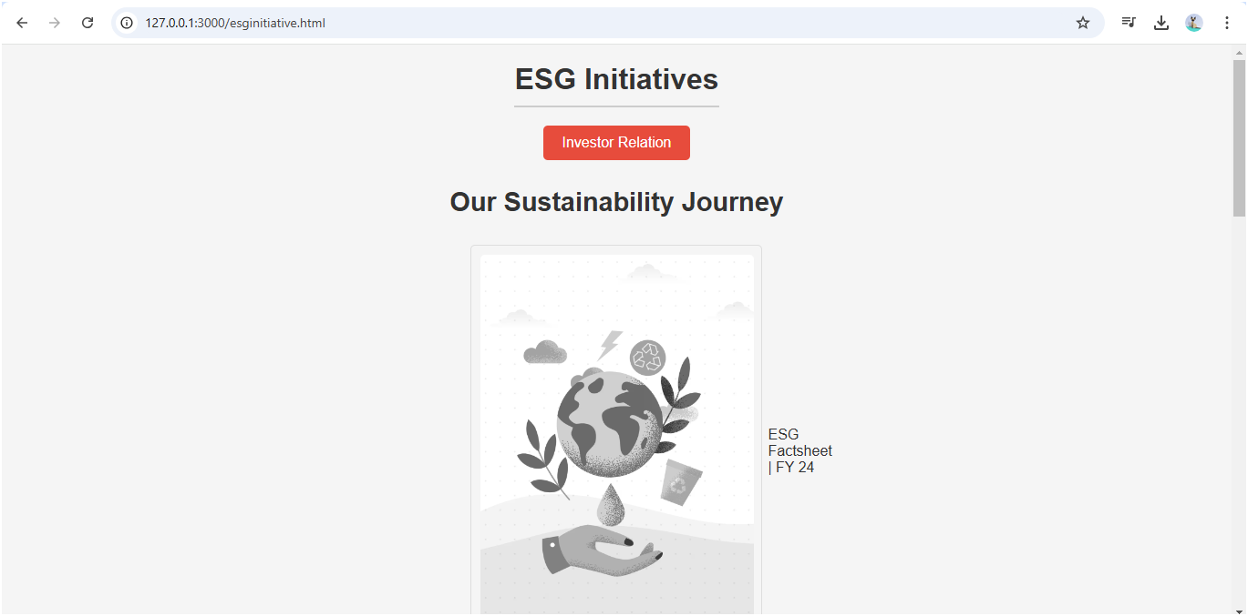
Investor Relations > ESG Initiatives page

Slide 43
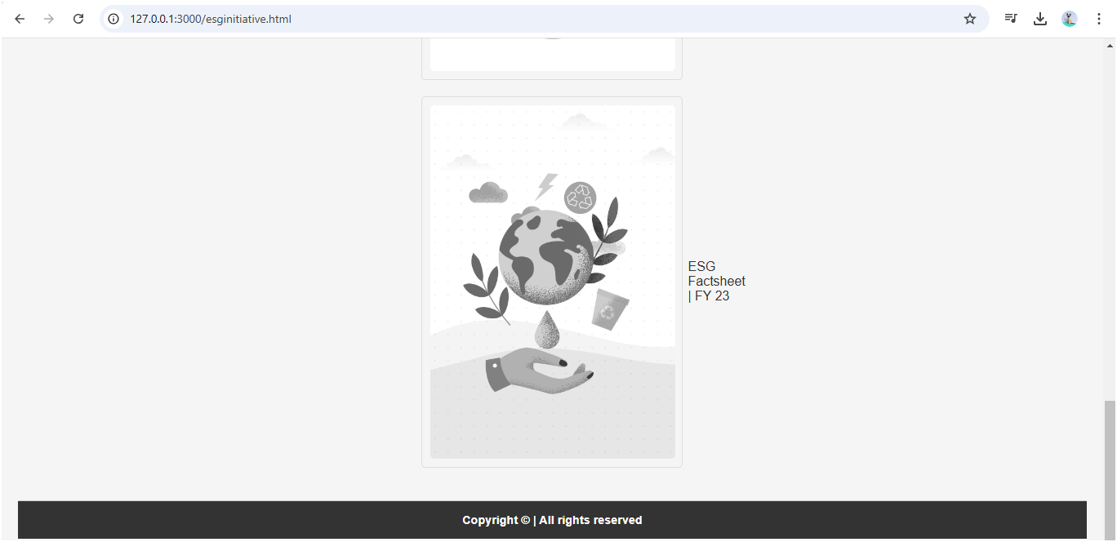

Slide 44
esginitiatives.html and esginitiatives.css
This HTML code creates a page dedicated to Zomato's Environmental, Social, and Governance (ESG) initiatives. The page includes a header with the title "ESG Initiatives" and a button linking to the investor relations page. The main section highlights various sustainability resources, with links to PDF reports such as the ESG Factsheet for FY 2024, Sustainability Highlights and Goals, CDP Report for FY 2024, and ESG Factsheet for FY 2023. Each report is accompanied by an image and is designed to open in a new tab. A footer is included with a copyright notice. The page is styled using an external CSS file.

Slide 45
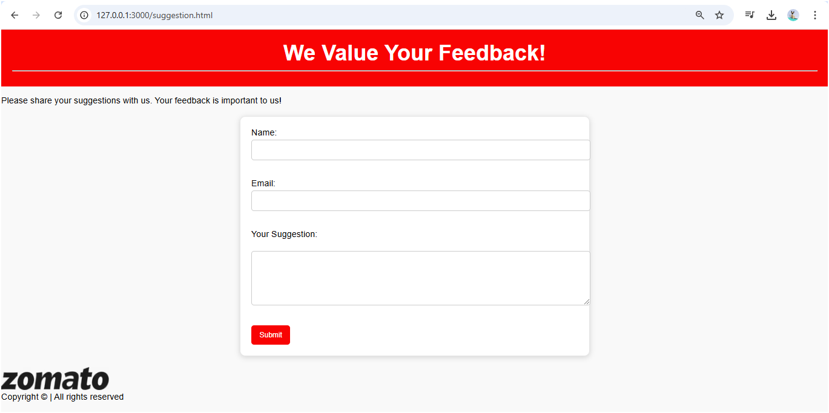
Investor Relations > Suggestion Page

Slide 46
suggestion.html and suggestion.css
This HTML code creates a page for users to provide feedback on a Zomato clone website. The page includes a header with the title "We Value Your Feedback!" and a brief message encouraging users to share their suggestions. The main section contains a form where users can input their name, email, and suggestions in designated fields. The form also includes a submit button. The page is styled with an external CSS file (suggestion.css). A footer with a logo and a copyright notice completes the page layout. The form fields are marked as required to ensure user input before submission.

Slide 47
THANK YOU ! ☺
I would like to express my sincere gratitude to for his constant guidance and support throughout the Abhishek Vora Sir development of our Zomato clone project. His insightful feedback and encouragement have played a crucial role in enhancing the quality of our work. Sir's patience and willingness to answer our queries, along with his valuable suggestions, have significantly contributed to our learning experience. We truly appreciate his dedication to helping us improve our skills, and we are grateful for the opportunity to submit this project under his mentorship. Thank you, Sir, for your unwavering support.
SUBMITTED TO:
Abhishek Vora Sir

